Slide 1
JAVASCRIPT

Slide 2
CONTENTS
What you need to know
Javascript
Introduction
History
What javascript can and cannot do
What Needed To write a Javascript
How And Where To Place JavaScript
Referencing An External File
Whitespace and Line Breaks
Semicolon
Case Sensitivity
Comments in JavaScript
Operators

Slide 3
WHAT YOU NEED TO KNOW?
You need to know basic html and css.
Html :Hypertext Markup Language.
  Content Structure
  What your headline
  How many divisions you have in your page
  How many paragraphs
  What are contents of paragraphs.
Css: Style Sheet For Presentation
  What’s the color and style of font
  The Width of paragraphs
  Background color of page

Slide 4
A Programming Language, Behavior and Interactivity with the page.
What happens when you move mouse over menu.
What happens when a user types in an invalid or wrong value in textfield.
How Long a photo Slide Show takes to move from one image to other.
JAVASCRIPT!

Slide 5
INTRODUCTION
JavaScript is an interpreted programming language with object-oriented (OO) capabilities.
JavaScript is a scripting language you can use — in conjunction with HTML — to create interactive Web pages.
A scripting language is a programming language that’s designed to give folks easy access to prebuilt components.
In the case of JavaScript, those prebuilt components are the building blocks that make up a Web page (links, images, HTML form elements, browser configuration details, and so on).
Syntactically, the core JavaScript language resembles C, C++, and Java, with programming constructs such as the if statement, the while loop, and the && operator.
JavaScript is a loosely typed language, which means that variables do not need to have a type specified.
It is commonly called client-side JavaScript to emphasize that scripts are run by the client computer rather than the web server.

Slide 6
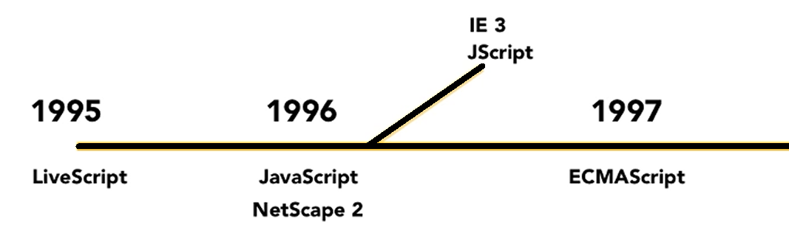
HISTORY
JavaScript was originally developed by Brendan Eich of Netscape under the name Mocha.
Later renamed to LiveScript.
Finally to JavaScript mainly because it was more influenced by the Java programming language.
JavaScript very quickly gained widespread success as a client-side scripting language for web pages.
As a consequence, Microsoft named its implementation JScript to avoid trademark issues.
JScript was included in Internet Explorer 3.0, released in August 1996.
In November 1996, Netscape announced that it had submitted JavaScript to Ecma International for consideration as an industry standard, and subsequent work resulted in the standardized version named ECMAScript.

Slide 7
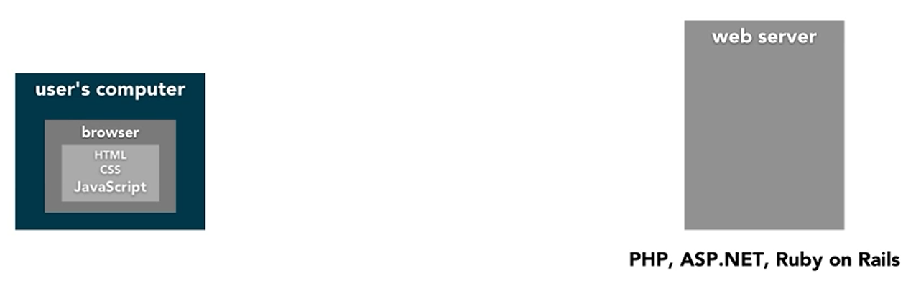
JAVASCRIPT
JavaScript is simply a scripting language.
Cannot write a desktop application
JavaScript is limited
Cannot access local files directly
Cannot directly access database
Cannot access hardware (As Usb, etc)
JavaScript was designed to manipulate webpages

Slide 8
WHAT JAVASCRIPT CAN DO?
JavaScript gives HTML designers a programming tool
JavaScript can put dynamic text into an HTML page
JavaScript can react to events
JavaScript can read and write HTML elements
JavaScript can be used to validate input data
JavaScript can be used to detect the visitor's
browser
JavaScript can be used to create cookies

Slide 9
WHAT NEEDED TO WRITE A JAVASCRIPT
It Doesn't matter it be
  Pc
  Mac,
  Linux
What ever language it be,
  Php
  ruby on rails
  Asp.net
No Licensing is need.
Some application may help in writing code.
But basically will work on a simple Text Editor.

Slide 10
HOW AND WHERE TO PLACE JAVASCRIPT
JavaScript consists of JavaScript statements that are placed within the <script>... </script> HTML tags in a web page.
The <script> tag alert the browser program to begin interpreting all the text between these tags as a script.
The script tag takes two important attributes:
language:
  This attribute specifies what scripting language you are using.
  Typically, its value will be “javascript”.
type:
  This attribute is what is now recommended to indicate the scripting language in use
  its value should be set to "text/javascript".
  <script language="javascript" type="text/javascript">
  JavaScript code
  </script>

Slide 11
HOW AND WHERE TO PLACE JAVASCRIPT
You Can place Script tag in
  head section: The browser interprets from top to bottom and head section is read first than the body. So will do some javascript work and then will show up content of body
  body section:
    Start: It will execute right after head.
    Middle: It will in middle of code
    End: Right at the end.
It depends on condition that you want a page to do processing before the content is rendered. Creating some dynamic content, then should do in Head Section.
There arise a need to process some elements in body then go ahead writing to body. Beware when code increases.
It could be the case you may load external javascript code as in css.

Slide 12
HOW AND WHERE TO PLACE JAVASCRIPT
  <html>
  <head>
    <script>
    alert("head");
    </script>
  </head>
  <body>
      <script> alert("start"); </script>
    <p>THis is text Wow</p>
    <p>some what in middel 1</p>
    <p>some what in middel 2</p>
    <script> alert("middle"); </script>
    <p>some what in midde 3</p>
    <p>some what in midde4</p>
    <p>finally end</p>
    <script>alert("end");</script>
    </body>
    </html>

Slide 13
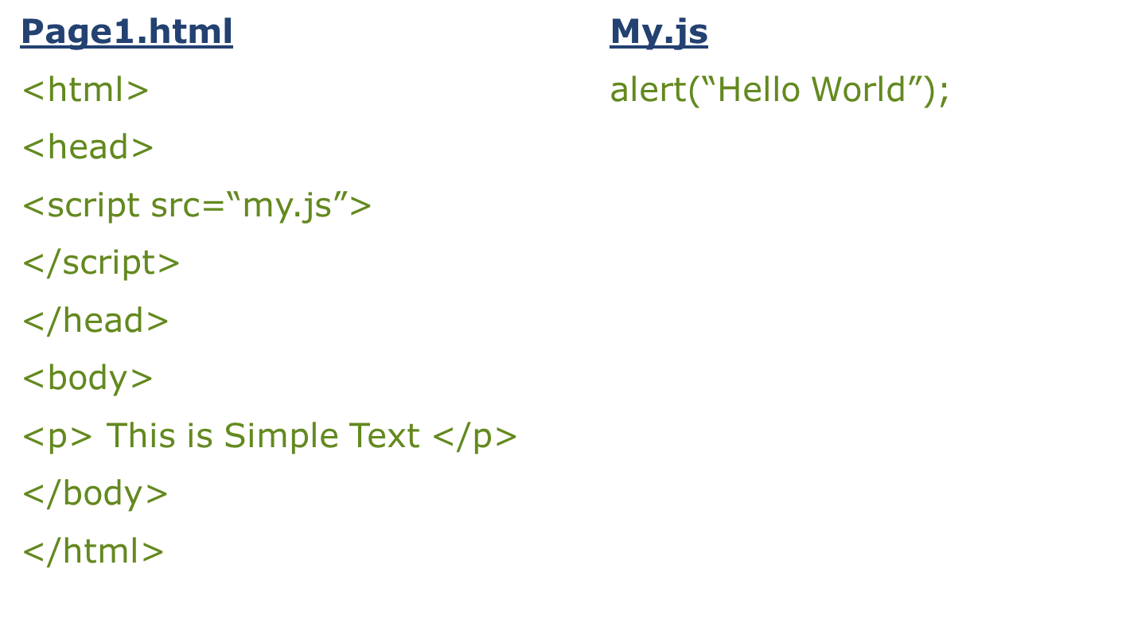
REFERENCING AN EXTERNAL FILE

Slide 14
WHITESPACE AND LINE BREAKS
JavaScript ignores
  spaces,
  tabs,
  newlines.
Because you can use spaces, tabs, and newlines freely in your programs, you are free to format and indent your programs in a neat and consistent way that makes the code easy to read and understand.

Slide 15
OPTIONAL SEMILCOLONS
Simple statements in JavaScript are generally followed by semicolons (;), just as they are in C, C++, and Java.
The semicolon serves to separate statements from each other.
In JavaScript, however, you may omit the semicolon if each of your statements is placed on a separate line.
<script language="javascript" type="text/javascript">
statement1
statement2
</script>

Slide 16
CASE SENSITIVITY
JavaScript is a case-sensitive language.
This means that
  language keywords,
  variables,
  function names,
  must always be typed with a consistent capitalization of letters.
So identifiers Test, TeSt and TEST will have different meanings in JavaScript.
Proper Care should be taken while writing your variable and function names in JavaScript.

Slide 17
COMMENTS IN JAVASCRIPT
JavaScript supports both C-style and C++ style comments
Any text between a // and the end of a line is treated as a comment and is ignored by JavaScript.
Any text between the characters /* and */ is treated as a comment. This may span multiple lines.
JavaScript also recognizes the HTML comment opening sequence
<!-- JavaScript treats
This as a single-line comment, just as it does the // comment.
The HTML comment closing sequence --> is not recognized by JavaScript so it should be written as //-->.

Slide 18
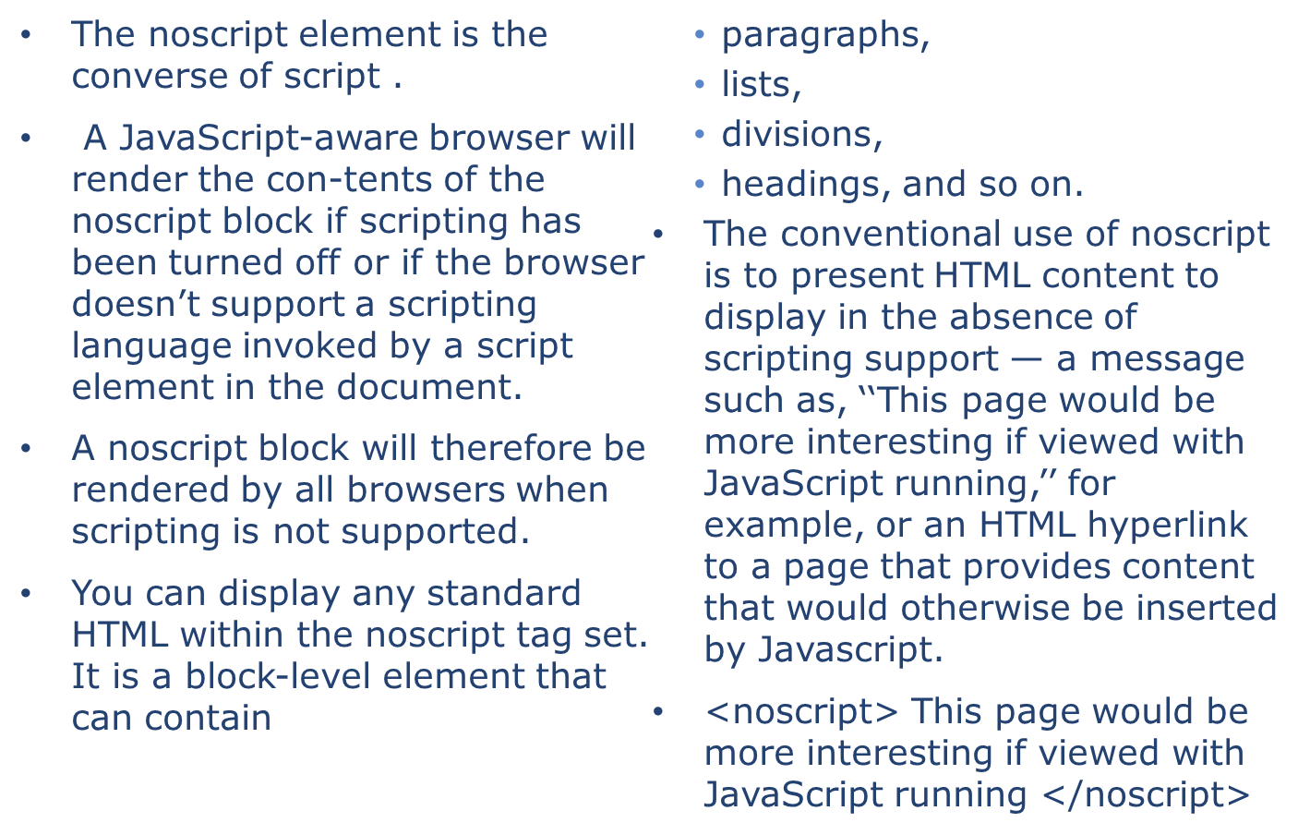
NO SCRIPT TAG

Slide 19
VARIABLES
In all programs we need to keep track of all kinds of data as email, date of birth and etc.
We create variables for the above purpose.
Variable is a container grabbing a piece of memory and giving it a name so we can use it in javascript.
We create varibale with the word var.
E.G
var value;
var name;

Slide 20
JAVASCRIPT VARIABLE SCOPE
The scope of a variable is the region of your program in which it is defined. JavaScript variable will have only two scopes.
Global Variables: A global variable has global scope which means it is defined everywhere in your JavaScript code.
Local Variables: A local variable will be visible only within a function where it is defined. Function parameters are always local to that function.

Slide 21
JAVASCRIPT VARIABLE NAMES
While naming your variables in JavaScript keep following rules in mind.
You should not use any of the JavaScript reserved keyword as variable name.
For example, break or boolean variable names are not valid.
JavaScript variable names should not start with a numeral (0-9). They must begin with A letter or the underscore character.
For example, 123test is an invalid variable name but _123test is a valid one.
JavaScript variable names are case sensitive. For example, Name and name are two different variables.

Slide 22
JAVASCRIPT DATATYPES
One of the most fundamental characteristics of a programming language is the set of data types it supports.
JavaScript allows you to work with three primitive data types:
  Numbers eg. 123, 120.50 etc.
  Strings of text e.g. "This text string" etc.
  Boolean e.g. true or false.
JavaScript also defines two trivial data types, null and undefined, each of which defines only a single value.
In addition to these primitive data types, JavaScript supports a composite data type known as object.

Slide 23
THE TYPEOF OPERATOR
The typeof is a unary operator that is placed before its single operand, which can be of any type. Its value is a string indicating the data type of the operand.
The typeof operator evaluates to "number", "string", or "boolean" if its operand is a number, string, or boolean value and returns true or false based on the evaluation.
Type | String Returned by typeof
Number | "number"
String | "string"
Boolean | "boolean"
Object | "object"
Function | "function"
Undefined | "undefined"
Null | "object"

Slide 24
OPERATORS
Using expression 4 + 5 is equal to 9.
  Here 4 and 5 are called operands and + is called operator.
JavaScript language supports following type of operators.
Arithmetic Operators
Comparision Operators
Logical (or Relational) Operators
Assignment Operators
Conditional (or ternary) Operators

Slide 25
The Arithmetic Operators
There are following arithmetic operators supported by JavaScript language:
Assume variable A holds 10 and variable B holds 20 then:
Operator | Description | Example
+ | Adds two operands | A + B will give 30
- | Subtracts second operand from the first | A - B will give -10
* | Multiply both operands | A * B will give 200
/ | Divide numerator by denumerator | B / A will give 2
% | Modulus Operator and remainder of after an integer division | B % A will give 0
++ | Increment operator, increases integer value by one | A++ will give 11
-- | Decrement operator, decreases integer value by one | A-- will give 9

Slide 26
THE COMPARISON OPERATORS
There are following comparison operators supported by JavaScript language
Assume variable A holds 10 and variable B holds 20 then:
Operator | Description | Example
== | Checks if the value of two operands are equal or not, if yes then condition becomes true. | (A == B) is not true.
!= | Checks if the value of two operands are equal or not, if values are not equal then condition becomes true. | (A != B) is true.
> | Checks if the value of left operand is greater than the value of right operand, if yes then condition becomes true. | (A > B) is not true.
< | Checks if the value of left operand is less than the value of right operand, if yes then condition becomes true. | (A < B) is true.
>= | Checks if the value of left operand is greater than or equal to the value of right operand, if yes then condition becomes true. | (A >= B) is not true.
<= | Checks if the value of left operand is less than or equal to the value of right operand, if yes then condition becomes true. | (A <= B) is true.

Slide 27
THE LOGICAL OPERATORS
There are following logical operators supported by JavaScript language
Assume variable A holds 10 and variable B holds 20 then:
Operator | Description | Example
&& | Called Logical AND operator. If both the operands are non zero then then condition becomes true. | (A && B) is true.
|| | Called Logical OR Operator. If any of the two operands are non zero then then condition becomes true. | (A || B) is true.
! | Called Logical NOT Operator. Use to reverses the logical state of its operand. If a condition is true then Logical NOT operator will make false. | !(A && B) is false.

Slide 28
THE ASSIGNMENT OPERATORS
Operator | Description | Example
= | Simple assignment operator, Assigns values from right side operands to left side operand | C = A + B will assigne value of A + B into C
+= | Add AND assignment operator, It adds right operand to the left operand and assign the result to left operand | C += A is equivalent to C = C + A
-= | Subtract AND assignment operator, It subtracts right operand from the left operand and assign the result to left operand | C -= A is equivalent to C = C - A
*= | Multiply AND assignment operator, It multiplies right operand with the left operand and assign the result to left operand | C *= A is equivalent to C = C * A
/= | Divide AND assignment operator, It divides left operand with the right operand and assign the result to left operand | C /= A is equivalent to C = C / A
%= | Modulus AND assignment operator, It takes modulus using two operands and assign the result to left operand | C %= A is equivalent to C = C % A

Slide 29
THE CONDITIONAL OPERATOR (? :)
Operator | Description | Example
? : | Conditional Expression | If Condition is true ? Then value X : Otherwise value Y

Slide 30
CONDITIONAL STATEMENTS
Conditional statements that allow your program to make correct decisions and perform right actions.
JavaScript supports following forms of if..else statement:
  if statement
  if...else statement
  if...else if... statement.

Slide 31
IF STATEMENT
The if statement is the fundamental control statement that allows JavaScript to make decisions, or, more precisely, to execute statements conditionally.
This statement has two forms. The first is:
  if (expression)
  statement
In this form, expression is evaluated. If the resulting value is true, statement is exe-cuted. If expression is false, statement is not executed.
Note that the parentheses around the expression are a required part of the syntax for the if statement.
JavaScript syntax requires a single statement after the if keyword and parenthesized expression, but you can use a statement block to combine multiple statements into one.

Slide 32
IF STATEMENT
  So the if statement might also look like this:
  if (expression)
  {
  statement;
  .
  .
  statement (n);
  }

Slide 33
IF ELSE STATEMENT
The second form of the if statement introduces an else clause that is executed when expression is false. Its syntax is:
if (expression)
statement1
else
statement2
This form of the statement executes statement1 if expression is true and executes statement2 if expression is false.

Slide 34
ELSE IF STATEMENT
The if...else if... statement is the one level advance form of control statement that allows JavaScript to make correct decision out of several conditions.
if (expression 1)
{
Statement(s) to be executed if expression 1 is true
}
else if (expression 2)
{
Statement(s) to be executed if expression 2 is true
}
else if (expression 3)
{
Statement(s) to be executed if expression 3 is true
}
else{
Statement(s) to be executed if no expression is true
}

Slide 35
ELSE IF
There is nothing special about this code. It is just a series of if statements, where each if is part of the else clause of the previous statement. Statement(s) are executed based on the true condition, if non of the condition is true then else block is executed.

Slide 36
SWITCH
You can use multiple if...else if statements, as in the previously learnt, to perform a multi way branch.
However, this is not always the best solution, especially when all of the branches depend on the value of a single variable.
You can use a switch statement which handles exactly this situation, and it does so more efficiently than repeated if...else if statements.
The basic syntax of the switch statement is to give an expression to evaluate
and
several different statements to execute based on the value of the expression.
The interpreter checks each case against the value of the expression until a match is found. If nothing matches, a default condition will be used.

Slide 37
SWITCH
switch (expression)
{
case condition 1: statement(s) break;
case condition 2: statement(s) break;
...
case condition n: statement(s) break;
default: statement(s)
}
The break statements indicate to the interpreter the end of that particular case. If they were omitted, the interpreter would continue executing each statement in each of the following cases.

Slide 38
LOOPS
The looping statements are those that bend that path back upon itself to repeat portions of your code.
While writing a program, there may be a situation when you need to perform some action over and over again. In such situation you would need to write loop statements to reduce the number of lines.
JavaScript has four looping statements:
  while
  do/while
  for
  for/in.

Slide 39
WHILE
The purpose of a while loop is to execute a statement or code block repeatedly as long asexpression is true. Once expression becomes false, the loop will be exited.
while (expression)
{
Statement(s) to be executed if expression is true
}

Slide 40
DO WHILE
The do...while loop is similar to the while loop except that the condition check happens at the end of the loop. This means that the loop will always be executed at least once, even if the condition is false.
  Do
  {
  Statement(s) to be executed;
  }
  while (expression);

Slide 41
FOR LOOP
The for loop is the most compact form of looping and includes the following three important parts:
The loop initialization where we initialize our counter to a starting value. The initialization statement is executed before the loop begins.
The test statement which will test if the given condition is true or not. If condition is true then code given inside the loop will be executed otherwise loop will come out.
The iteration statement where you can increase or decrease your counter.
for (initialization; test condition; iteration statement)
{
Statement(s) to be executed if test condition is true
}

Slide 42
LOOP CONTROL
To handle all such situations, JavaScript provides break and continue statements. These statements are used to immediately come out of any loop or to start the next iteration of any loop respectively.
The break Statement:
The break statement, which was briefly introduced with the switch statement, is used to exit a loop early, breaking out of the enclosing curly braces.
The continue Statement:
The continue statement tells the interpreter to immediately start the next iteration of the loop and skip remaining code block.
When a continue statement is encountered, program flow will move to the loop check expression immediately and if condition remain true then it start next iteration otherwise control comes out of the loop.

